Slide 1
Receipt and Invoice Digitizer
Milestone 1 Review

Slide 2
Problem Statement
Businesses and individuals handle numerous paper receipts and invoices, which are prone to loss, errors, and manual entry delays. This project builds a system that automatically scans, extracts, and digitizes information from receipts and invoices using OCR (Optical Character Recognition) and NLP-based field extraction. The digitized data is stored in a structured format, making it easy to search, analyze, and integrate with accounting or ERP systems.
There is a strong need for automation in document digitization.

Slide 3
Motivation
Growing volume of digital and scanned invoices
Manual bookkeeping affects productivity
Errors in financial data can cause losses
Automation improves accuracy and speed
OCR-based solutions enable faster and reliable financial processing.

Slide 4
Objective of Milestone 1
Document Ingestion & OCR
Implement file upload.
Preprocess images for OCR.
Extract raw text from sample receipts.

Slide 5
Supported Input Formats
The system supports:
Image files: JPG, JPEG, PNG
PDF files: Single-page and multi-page invoices
PDFs are converted into images to maintain a uniform OCR pipeline.

Slide 6
System Architecture Overview
Workflow:
User uploads invoice/receipt
PDF → Image conversion (if required)
Image preprocessing using OpenCV
Text extraction using Tesseract OCR
Display output via Streamlit interface
The architecture is modular, scalable, and maintainable.

Slide 7
Image and PDF Input Considerations
Challenges in Raw Image Quality
Handling PDF Documents
Image-based invoices are often scanned at low resolution or with poor lighting, leading to degraded text quality and OCR inaccuracies.
Preprocessing steps such as noise reduction, contrast enhancement, and binarization are essential to improve text readability.
PDF invoices may contain multiple pages or complex layouts with tables and headers.
We use pdf2image to convert PDFs into individual image pages for consistent processing.

Slide 8
End-to-End Processing Pipeline
System Architecture and Workflow

Slide 9
System Architecture and Workflow
The system follows a modular workflow: user uploads an image → applies preprocessing → performs OCR using Tesseract → extracts structured data → displays results in a clean interface via Streamlit. The architecture is designed for scalability, with clear separation between input handling, image processing, OCR, and output display. This ensures maintainability and ease of debugging during development.

Slide 10
Technologies Used
Component | Technology
Frontend | Streamlit
OCR Engine | Tesseract OCR
Image Processing | OpenCV
PDF Processing | pdf2image + Poppler
Language | Python

Slide 11
Image Preprocessing Pipeline
Image Preprocessing Steps
Enhancing Text Readability
Noise reduction using Gaussian blur helps eliminate speckles and dust patterns.
Contrast adjustment enhances text visibility against the background.
Binarization converts grayscale images into black-and-white, improving OCR performance.
Deskewing corrects tilted documents to align text properly.

Slide 12
OCR Implementation Details
Tesseract is configured with custom language models and layout analysis to detect structured fields. The system uses page segmentation modes to identify regions of interest (e.g., header, body, footer). For better accuracy, we apply layout analysis to detect tables and align text blocks. The extracted text is then parsed using regular expressions to extract key fields such as date, amount, and vendor name. This ensures structured output suitable for further integration into financial databases.

Slide 13
Results and Learnings
Sample Output and Challenges

Slide 14
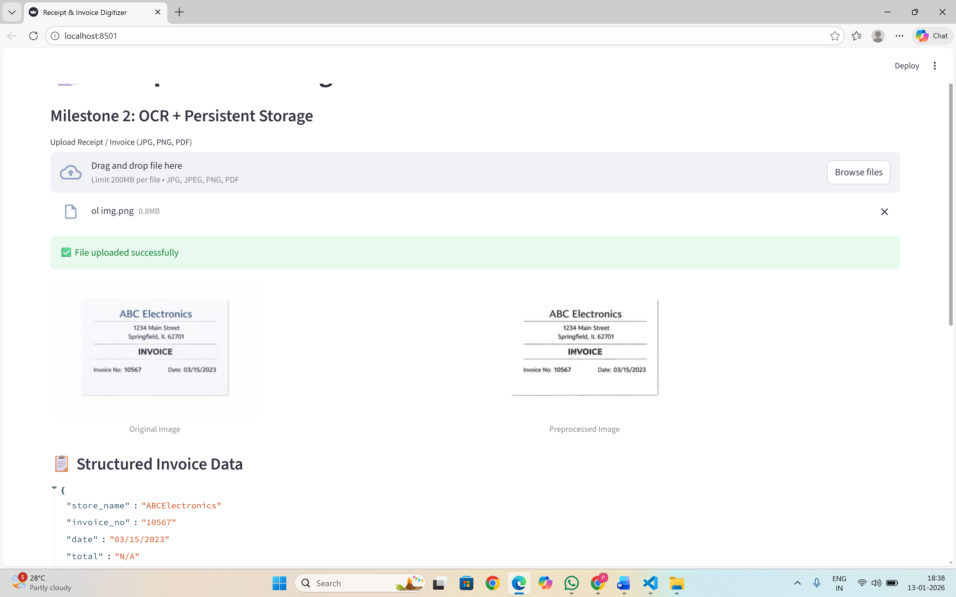
Output and Screenshots

Slide 15
Conclusion
Milestone 1 successfully demonstrated a functional prototype for automated receipt and invoice digitization using OCR. The system is accurate, efficient, and scalable for real-world use. Future work includes integrating with accounting software like QuickBooks or Xero, adding support for more languages, implementing machine learning models for better layout detection, and introducing user feedback loops to improve accuracy over time. This project lays a strong foundation for a full-scale digital finance automation solution.

Slide 16
Thank You

